Slide 1
Wellness presentation
70% business

Slide 2
ROLE OF FOOD SUPPLEMENT
DETOX
AND
NOURISHMENT

Slide 3








Slide 4

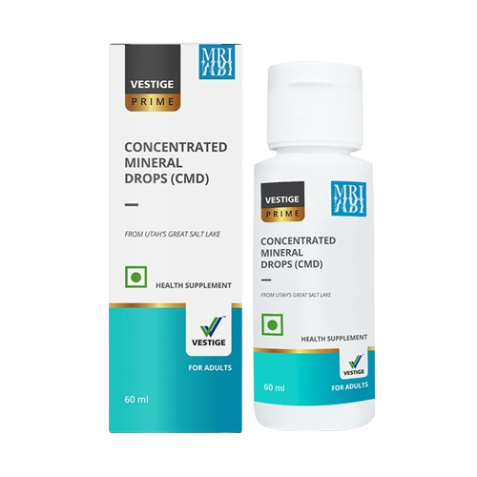


Slide 5
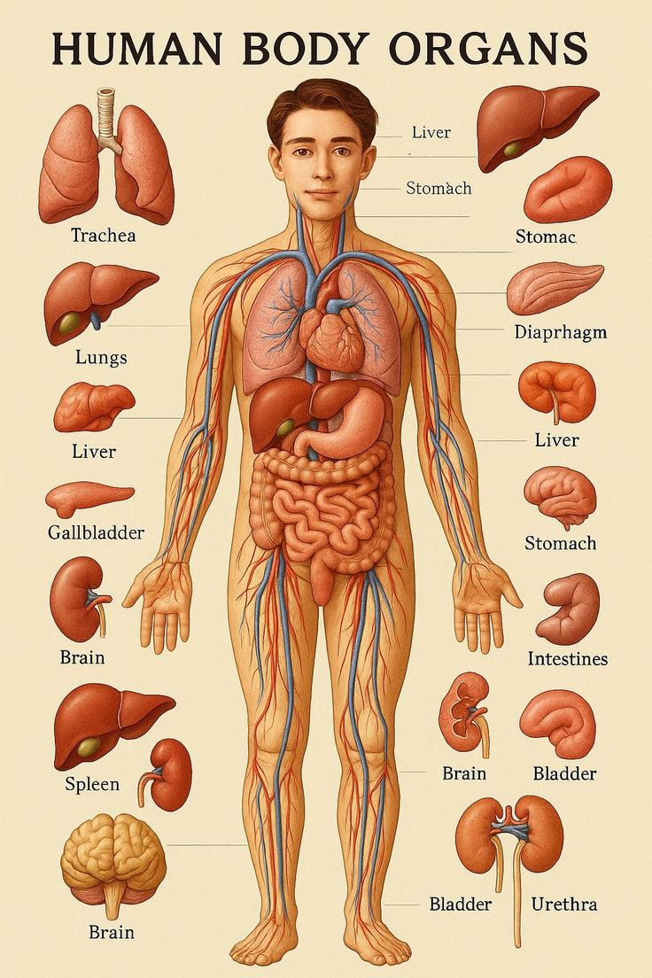

DETOX and NOURISHMENT

Slide 6
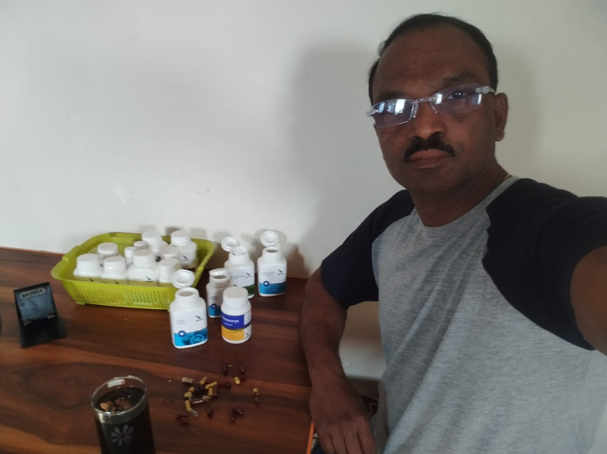
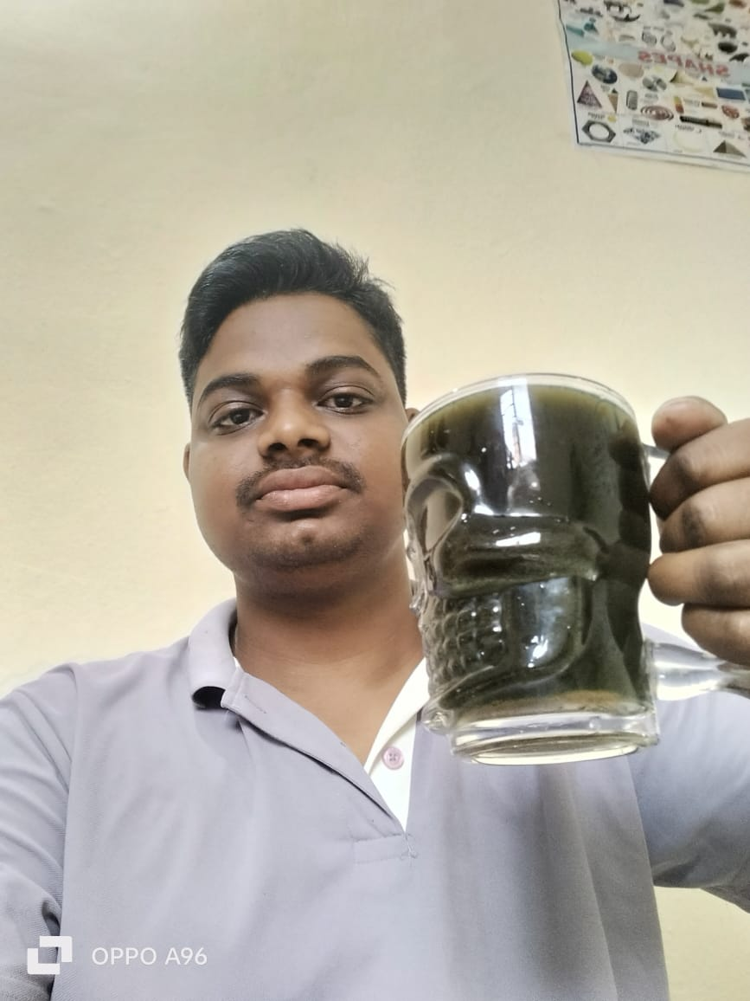
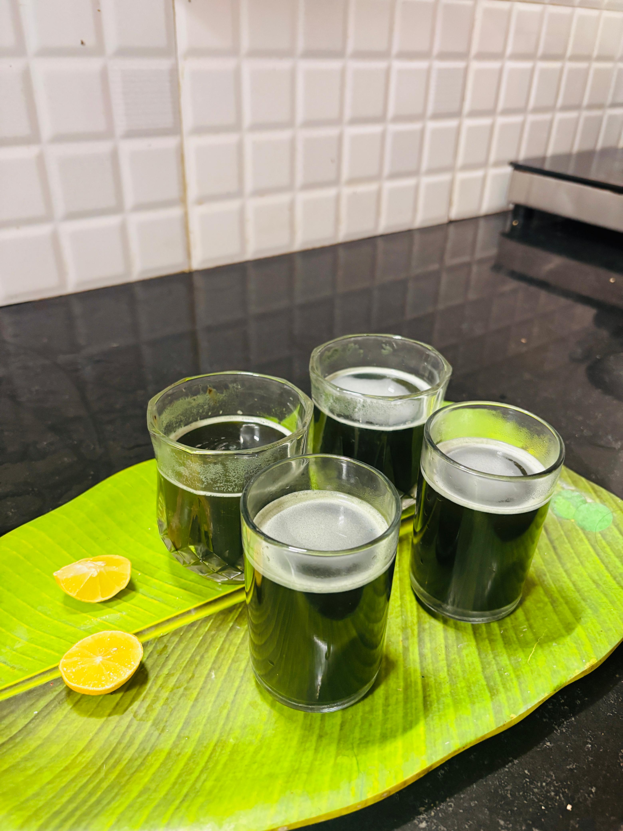
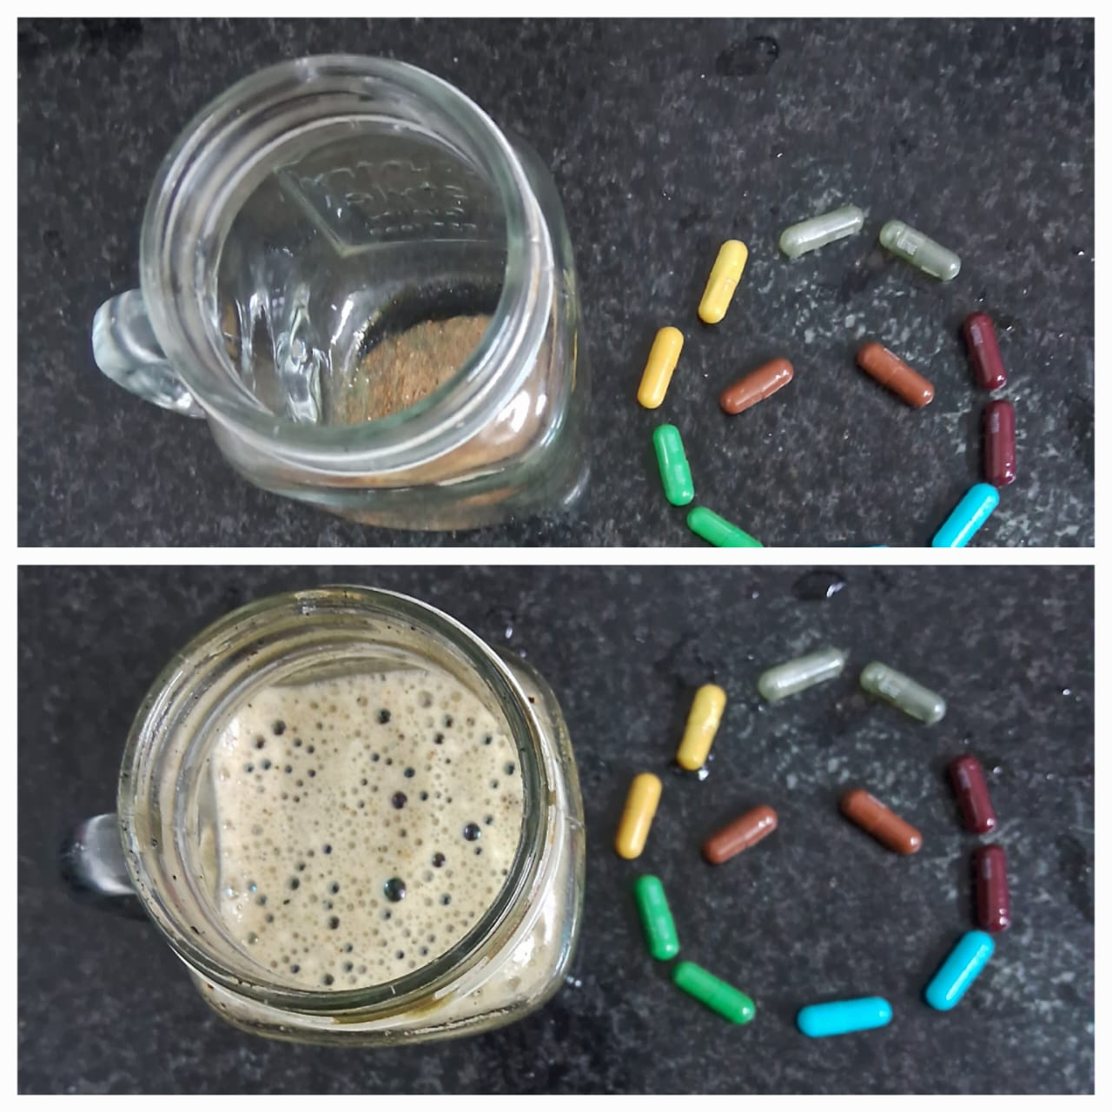
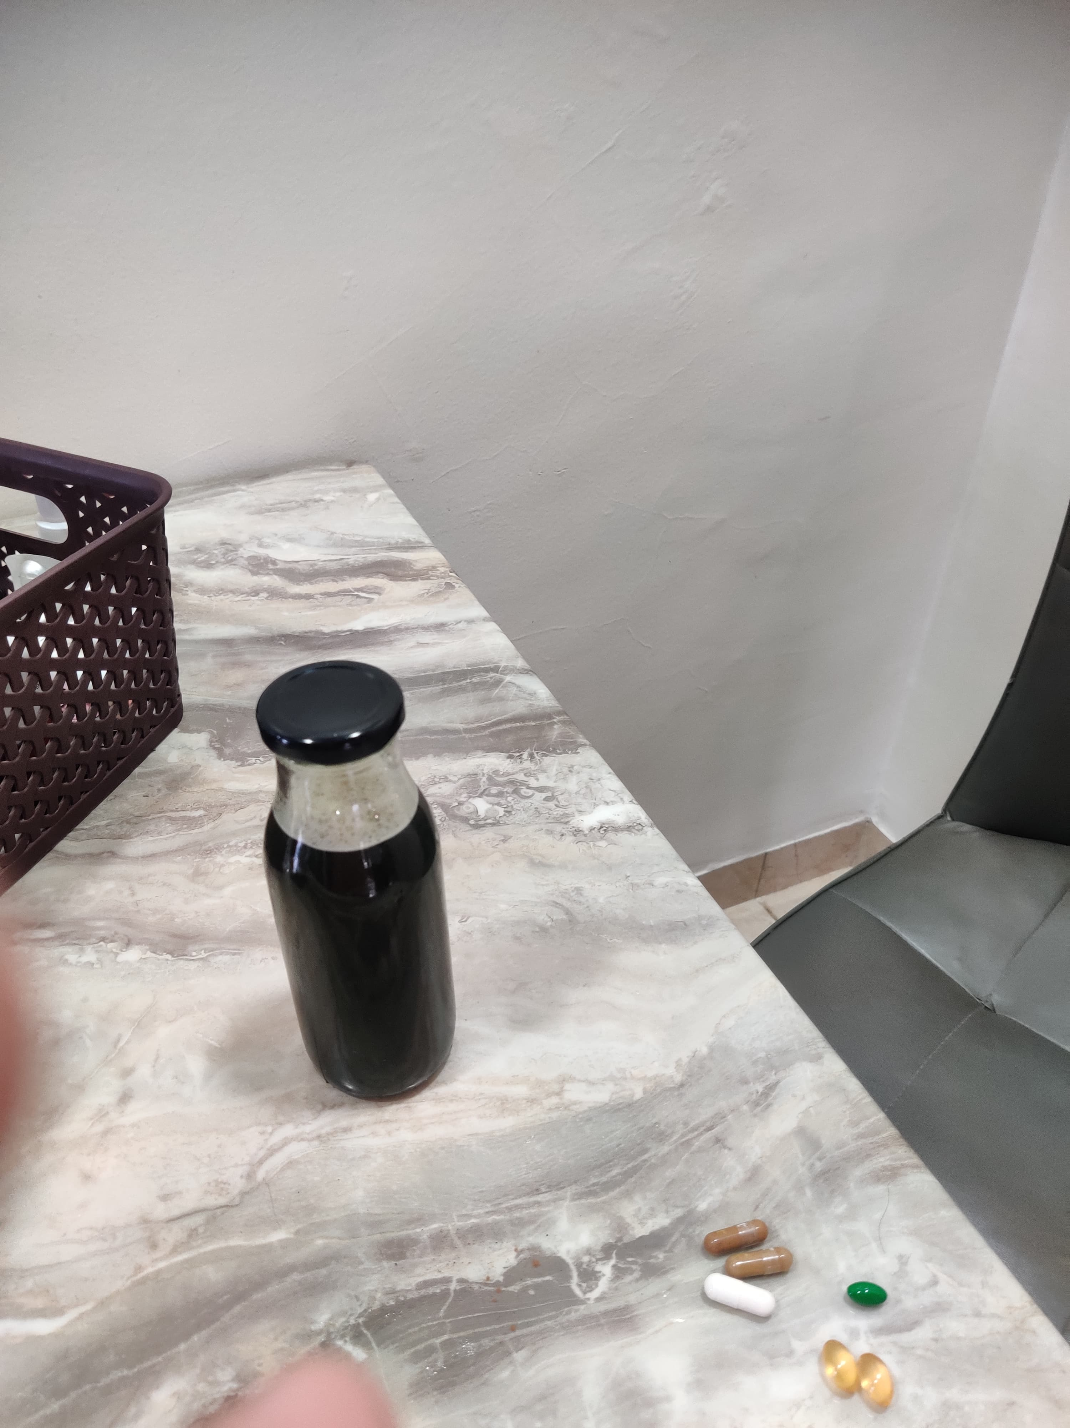
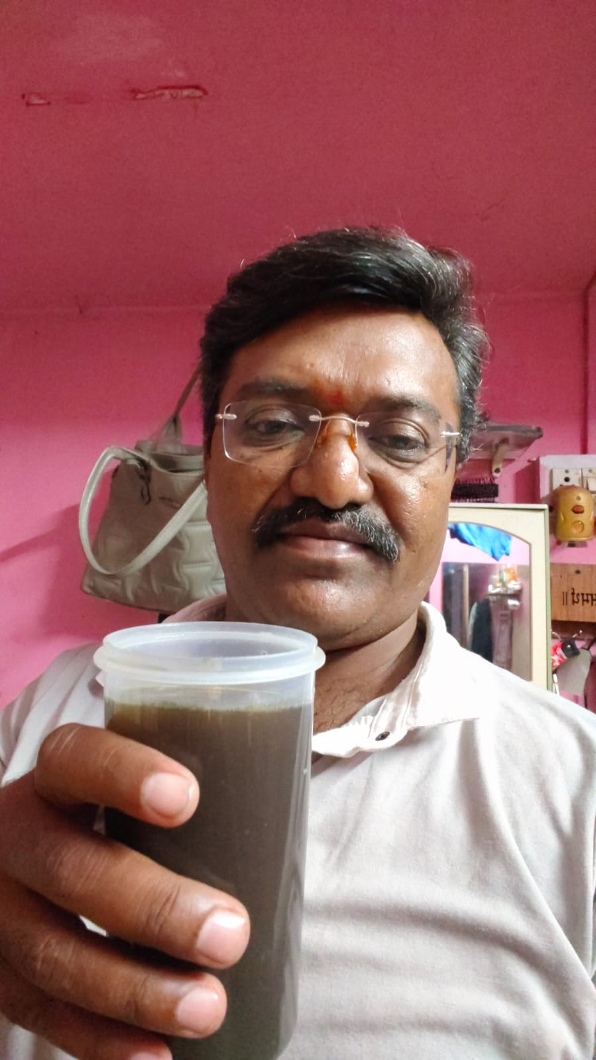
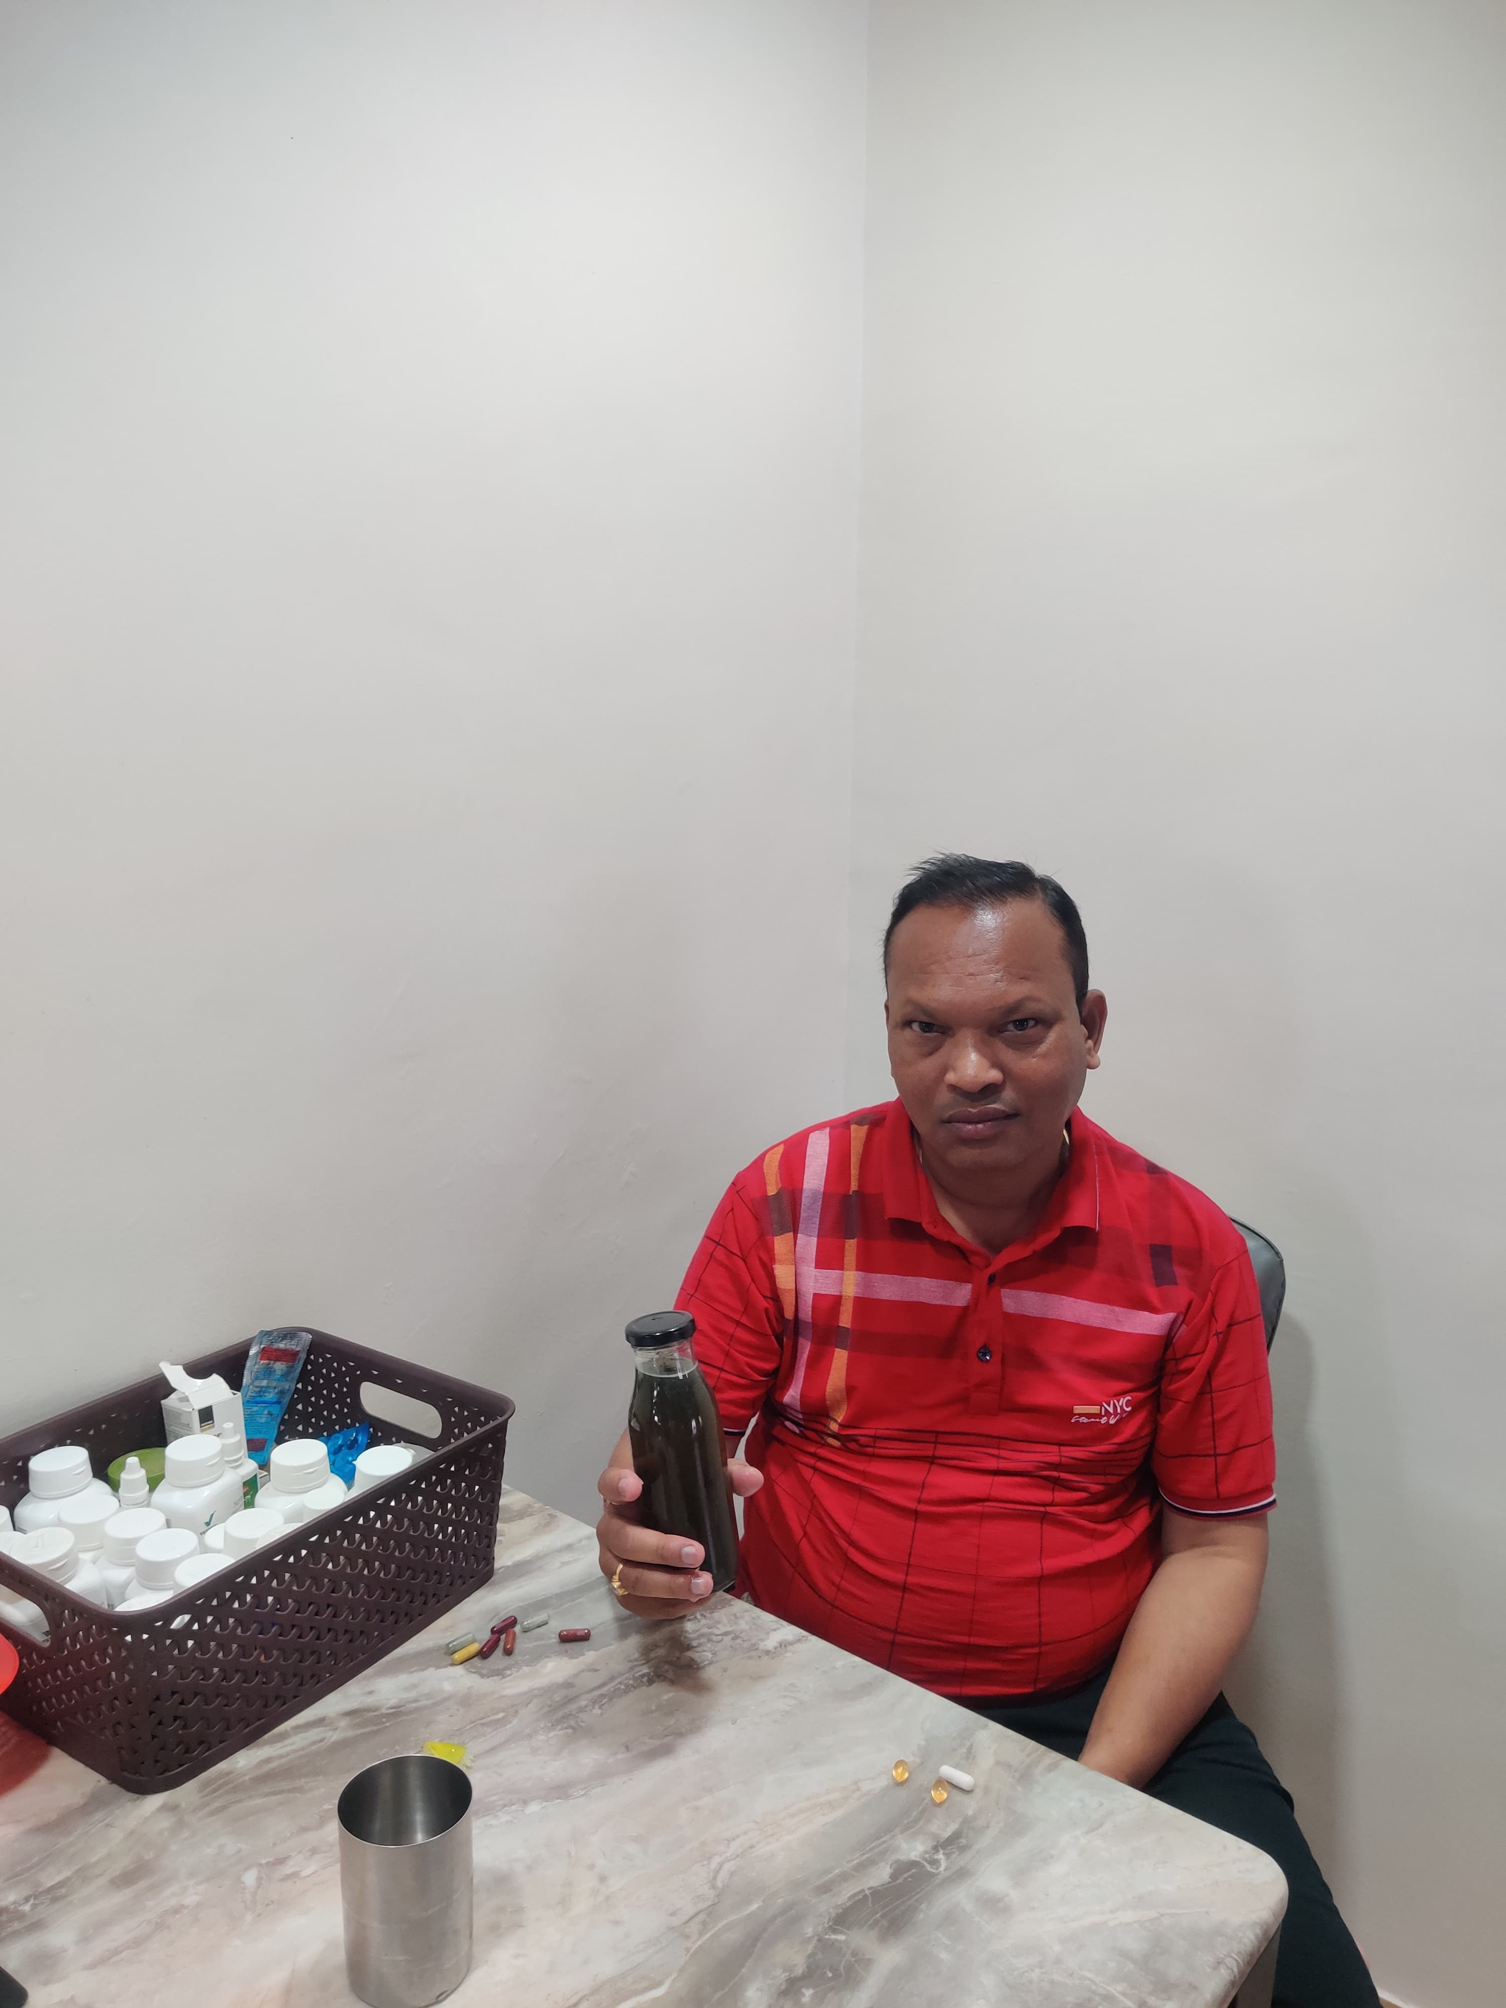
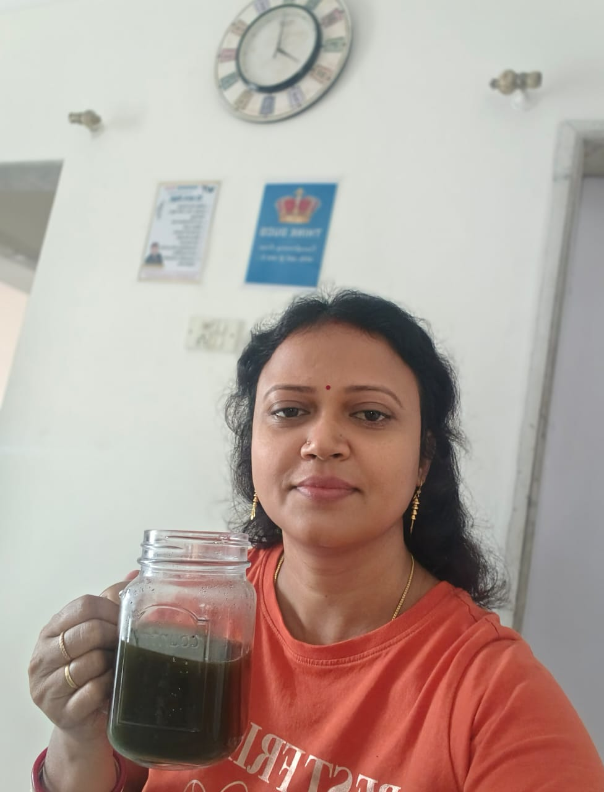

Slide 7











Slide 8










Slide 9
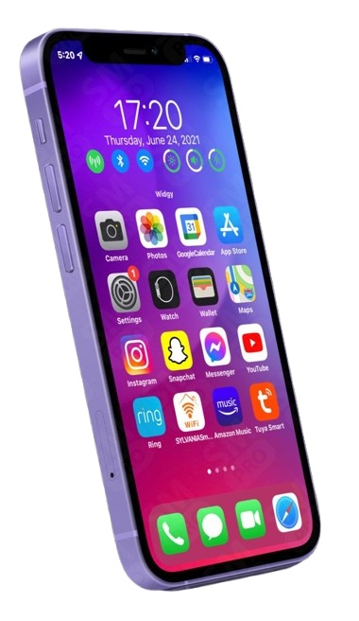
SCREEN TIME
DISTRACTION
DIGITAL WELLBEING & PARENTAL CONTROLS
WINNING TEAM CEP APP TIME ?

Slide 10
INVEST YOUR TIME ON WT CEP APP
ASSOCIATION OF MILLIONAIRES
LEARNING IS EARNING

Slide 11
MISSION 90 DAYS
WHAT WE HAVE TO DO ?

